Slide 1


GNR - 652 COURSE PROJECT
HybridSN: Exploring 3-D–2-D CNN Feature Hierarchy for Hyperspectral Image Classification
Submitted to :-
Presented by:-
Prof. Biplab Banerjee
22M0316 : Piyush Ashokrao Kene
22M0303 : Mohit Panwar
22M0312 : Ajinkya Rajendra Dewalkar

Slide 2
Introduction:-
Hyperspectral imaging is an important technology that provide valuable information about the area of interest by capturing data in a large number of contiguous spectral bands
High dimensionality and complex spectral signatures possess a challenging task to analyze and process hyperspectral images.
Convolutional neural networks (CNNs) have emerged as the most popular deep learning technique for image classification tasks due to their ability to automatically learn hierarchical features from the input data.

Slide 3
Convolution Neural Network(CNN):-
Convolutional Neural Networks (CNNs) are a type of deep learning algorithm used for image and video processing tasks
The architecture of a CNN typically consists of several layers like convolutional layers, pooling layers, fully connected layers, dropout layers, batch normalization layers, and activation functions like ReLU or sigmoid.

Slide 4
HybridSN:-
HybridSN is a hybrid CNN architecture that combines 3-D and 2-D CNNs to exploit the spatial and spectral information of hyperspectral images.
In HybridSN the 3-D-CNN facilitates the joint spatial–spectral feature representation from a stack of spectral bands.
The 2-D-CNN on top of the 3-D-CNN further learns more abstract-level spatial representation
Moreover, the use of hybrid CNNs reduces the complexity of the model compared to the use of 3-D-CNN alone.

Slide 5
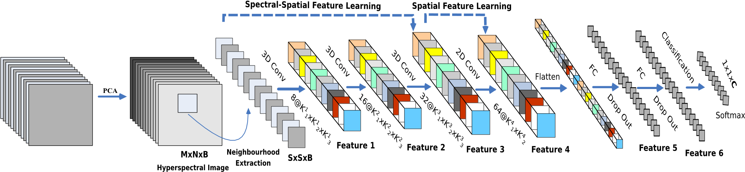
Network:-
HybridSpectralNet (HybridSN) model that integrates 3-D and 2-D convolutions for HSI classification
HybridSN: Exploring 3-D–2-D CNN Feature Hierarchy for Hyperspectral Image Classification | IEEE Journals & Magazine | IEEE Xplore

Slide 6
Input Data:-
AVIRIS HYPERSPECTRAL DATA
Spectral channels with wavelengths from 400 to 2500 nanometers.
Number of Bands – 220
Radiometric Resolution – 12 bits
Spatial Resolution - 20 m resolution

Slide 7
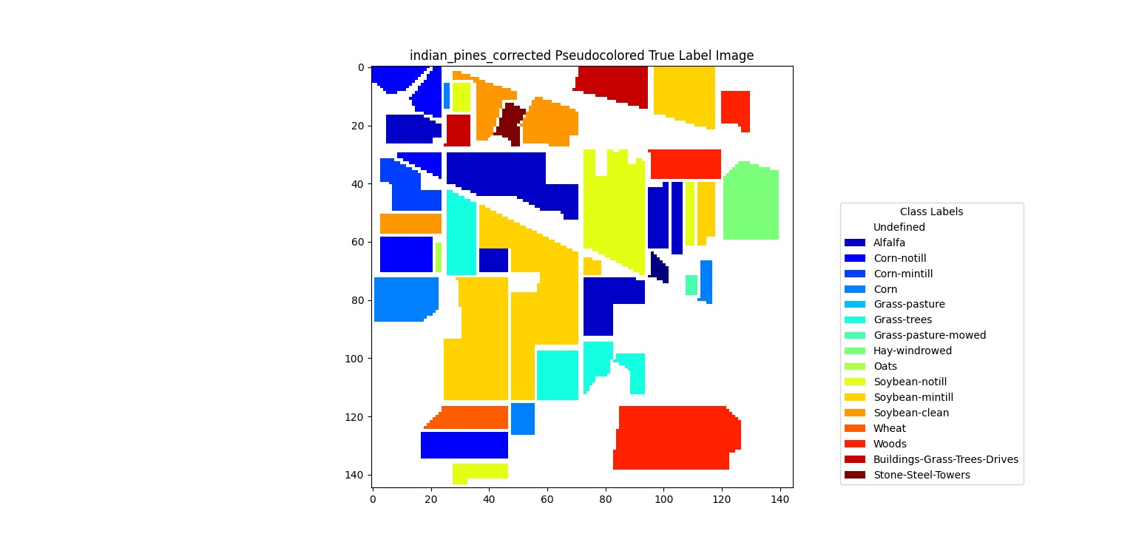
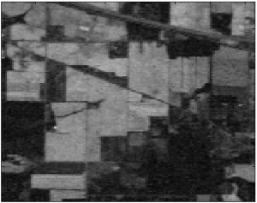
Indian Pines
HYPERSPECTRAL IMAGE
PSEUDOCOLORED IMAGE

Slide 8
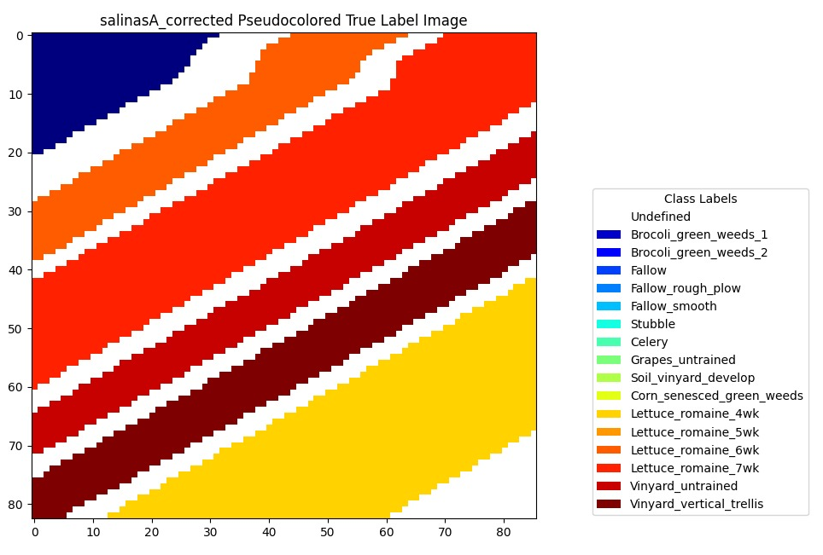
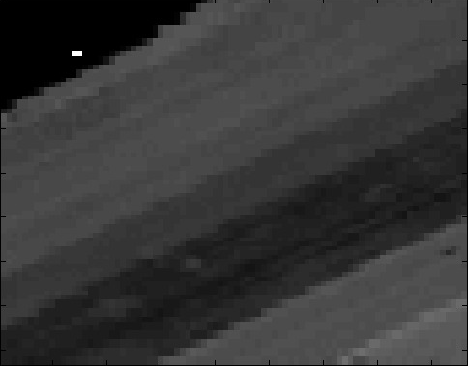
Salinas-A
HYPERSPECTRAL IMAGE
PSEUDOCOLORED IMAGE

Slide 9
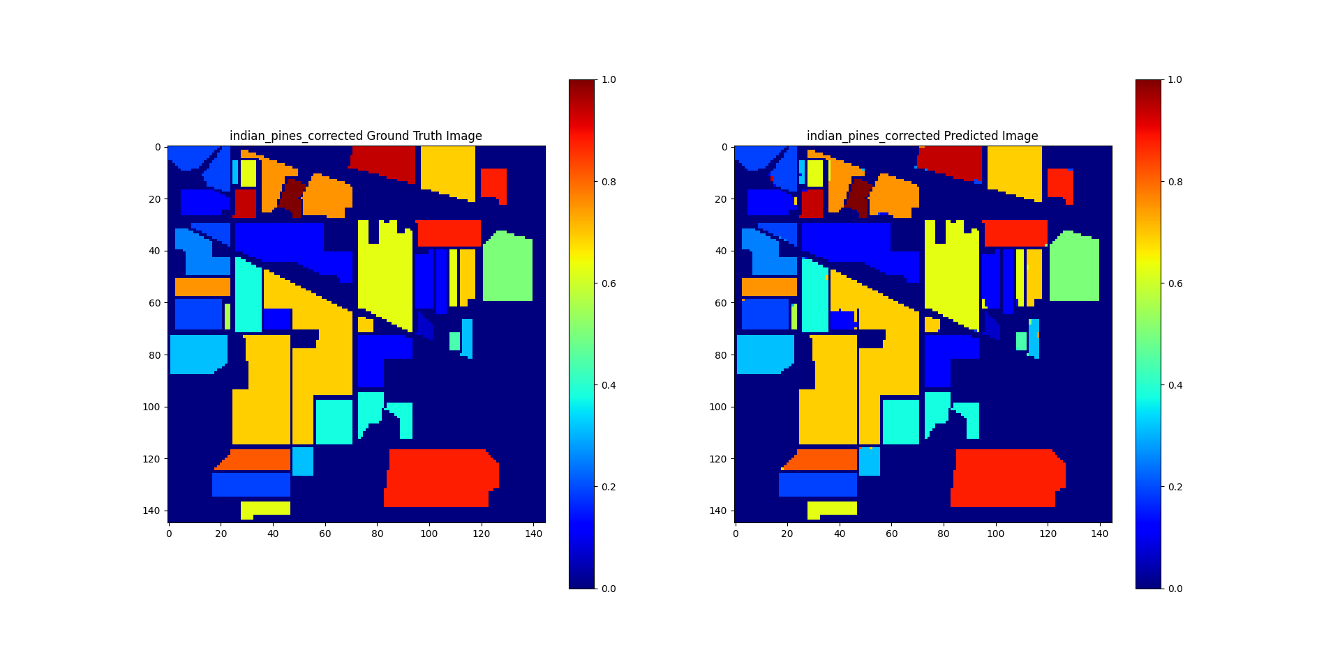
Results:-
Indian Pines image data with 30 epochs for training

Slide 10
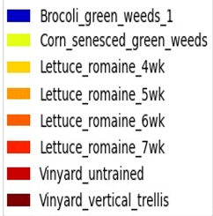
Salinas-A image data with 30 epochs for training

Slide 11
References:-
S. K. Roy, G. Krishna, S. R. Dubey and B. B. Chaudhuri, "HybridSN: Exploring 3-D–2-D CNN Feature Hierarchy for Hyperspectral Image Classification," in IEEE Geoscience and Remote Sensing Letters, vol. 17, no. 2, pp. 277-281, Feb. 2020, doi: 10.1109/LGRS.2019.2918719.
Y. Wang, "Hyperspectral image classification based on Hybrid 2D-3D CNN," 2022 IEEE International Conference on Advances in Electrical Engineering and Computer Applications (AEECA), Dalian, China, 2022, pp. 1449-1454, doi: 10.1109/AEECA55500.2022.9918934.

Slide 12
THANK YOU!

